Slide 1
Slaviša Đurđić
IMBD
IMDB (an acronym for Internet Movie Database) is an online database of information related to films, television series, podcasts, home videos, video games, and streaming content online – including cast, production crew and personal biographies, plot summaries, trivia, ratings, and fan and critical reviews.
https://en.wikipedia.org/wiki/IMDb
Goal: Analysis of the imdb dataset by genres and types for titles made after year 1950.
Instructions:
- Collect data from the "bigquery-public-data.imdb.title_basics“ and "bigquery-public-data.imdb.title_ratings" datasets available on BigQuery.
- Load the data to MySQL table(s).
- Execute some basic SQL queries to get first insights about the data.
- Build visuals in Power BI Desktop.
- Test hypothesis.
Belgrade, May 2023

Slide 2
MySQL queries
It seems that there are no duplicates:
WITH cte AS (
SELECT tconst, title_type, primary_title, original_title, is_adult, start_year, end_year, runtime_minutes, genres,
ROW_NUMBER() OVER(PARTITION BY tconst, title_type, primary_title, original_title, is_adult, start_year, end_year, runtime_minutes, genres) AS RN
FROM data_analysis.publicbigquery_imdb_title_basics
)
SELECT *
FROM cte
WHERE RN > 1;
Confirmed that count of unique genres:
SELECT COUNT(DISTINCT(genres)) AS number_of_unique_genres FROM data_analysis.publicbigquery_imdb_title_basics;
> number_of_unique_genres
> 2339

Slide 3
MySQL queries
The last 5 titles (planned start year):
SELECT tconst, title_type, primary_title, start_year, genres
FROM data_analysis.publicbigquery_imdb_title_basics
WHERE genres = 'Comedy'
ORDER BY start_year DESC
LIMIT 5;
> tconst title_type primary_title start_year genres
> tt13984170 movie C.O.M.M.U.N.I.C.A.T.I.O.N. 2025 Comedy
> tt27897848 tvMovie Way 2 Go Bistro 2025 Comedy
> tt12929950 movie Bakom varje man 2025 Comedy
> tt27385073 movie The Devil Who Threw Fire 2025 Comedy
> tt11742154 movie SUBWAY! the movie 2025 Comedy

Slide 4
MySQL queries
Average rating:
SELECT AVG(average_rating) as average_rating
FROM data_analysis.publicbigquery_imdb_title_ratings;
> average_rating
> 6.9545820325695695
Average rating:
SELECT genres, AVG(average_rating) AS average_rating
FROM data_analysis.publicbigquery_imdb_title_basics tb
JOIN data_analysis.publicbigquery_imdb_title_ratings tr
ON tb.tconst = tr.tconst
WHERE genres IN ('Horror', 'Comedy', 'Action')
GROUP BY genres
ORDER BY AVG(average_rating) DESC
> genres average_rating
> Comedy 6.905865066714559
> Action 6.115749630377521
> Horror 5.058645758206431

Slide 5

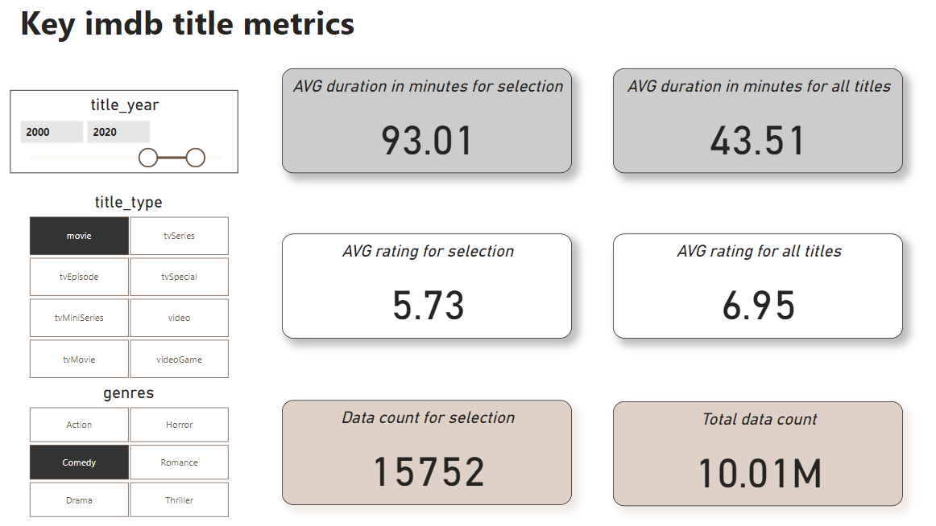
Microsoft Power BI

Slide 6
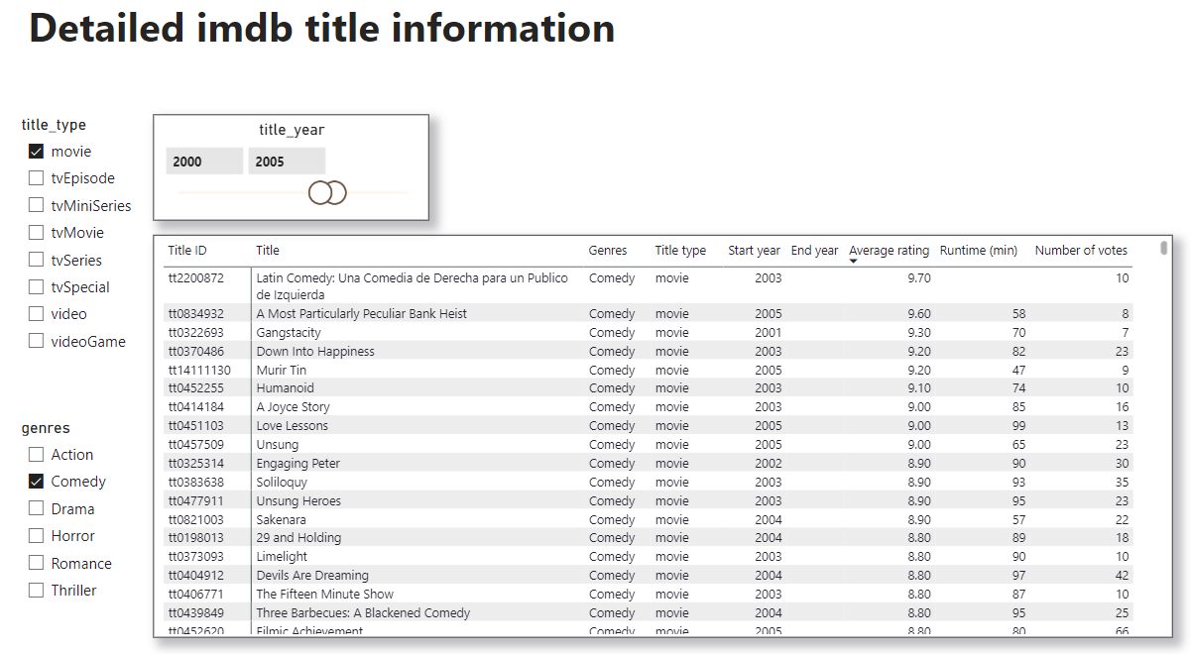
Microsoft Power BI

Slide 7
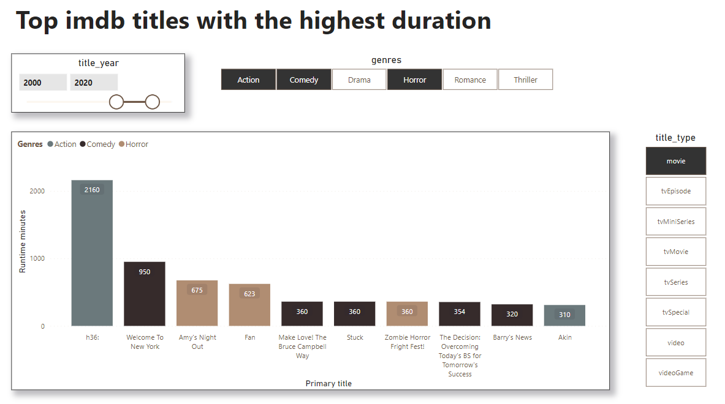
Microsoft Power BI

Slide 8
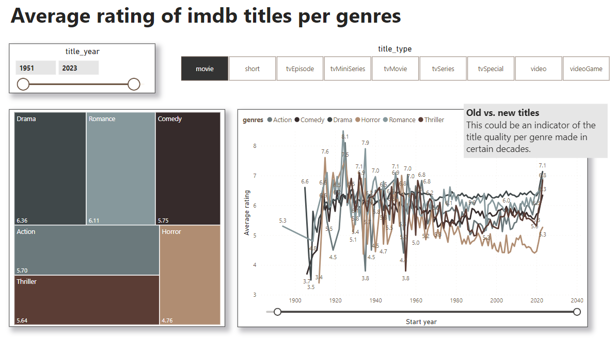
Microsoft Power BI

Slide 9
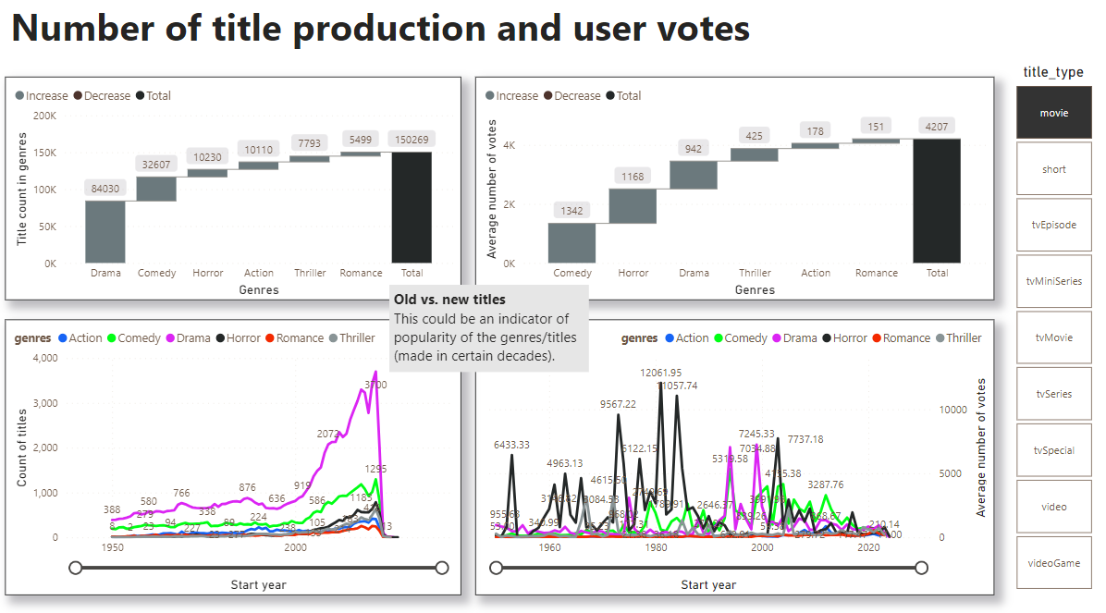
Microsoft Power BI

Slide 10
IMDB Project Insights
1) Overall, the majority of movies fall under the "Drama", "Comedy", and "Horror", respectively.
2) Similar to the previous point, the highest number of votes, on average, go to the "Comedy", "Horror", and "Drama", respectively. If we assume a positive linear correlation between number of votes and people watching this, we can see user preferences about the genres.
3) With respect to above, if we want to make a movie, we can decide to go with a comedy, as a less risky option. We can see that there is a significant increase in number of comedies in the last two decades. Furthermore, it seems that the most popular comedies are those made in period 1999-2005. We can filter by these parameters to check further which movies have the best average rating (on the other hand, please note that the average rating of all comedies is 5.73, lower than the global title average of 6.95). For example, we can decide to make a movie similar to one of the 10 bellow titles:
- A Most Particularly Peculiar Bank Heist
- Gangstacity
- Down Into Happiness
- Murir Tin
- Humanoid
- A Joyce Story
- Love Lessons
- Unsung
- Soliloquy
- Unsong Heroes

